Slide 1
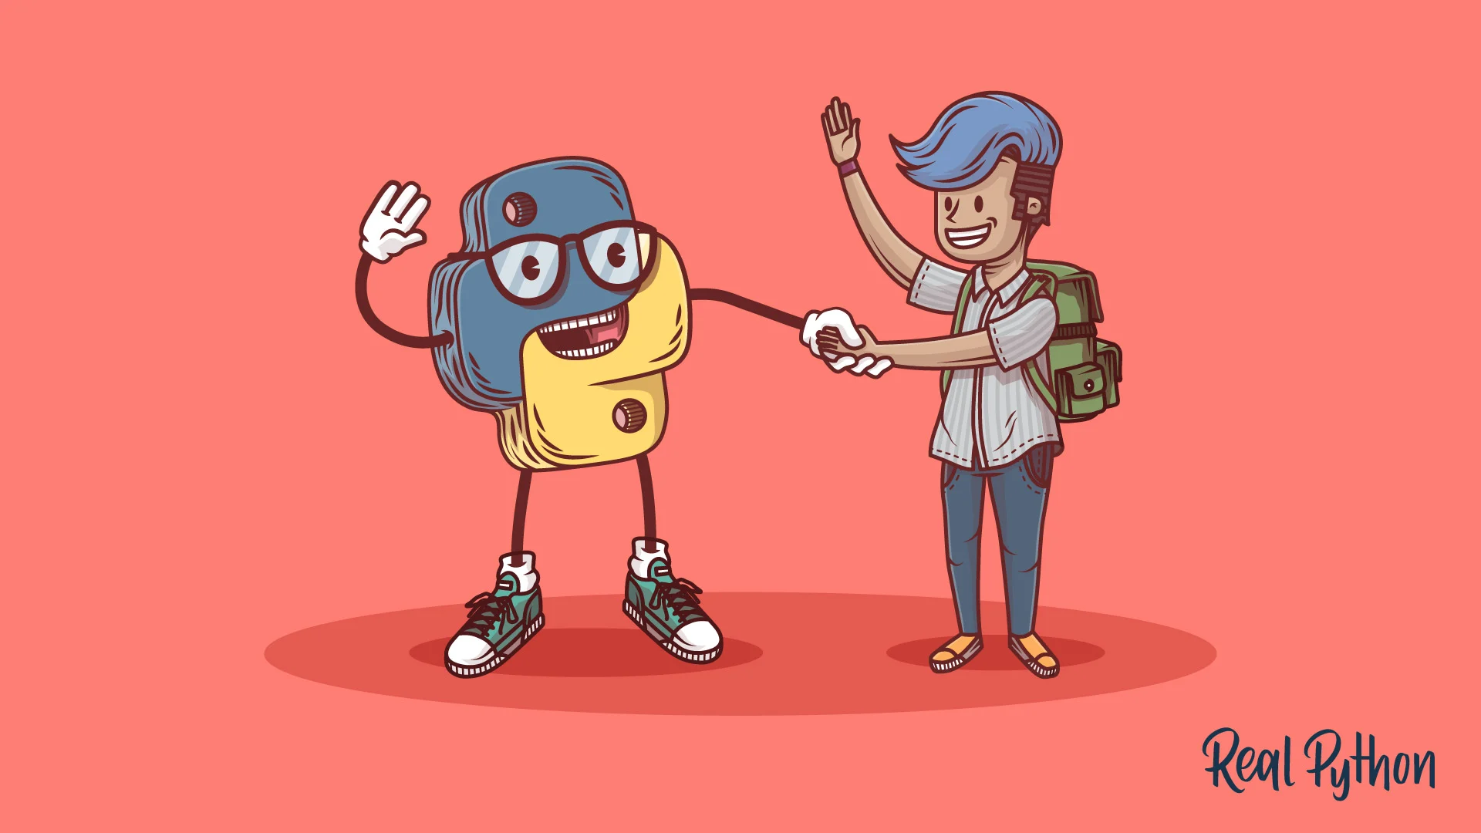
PYTHON

Slide 2
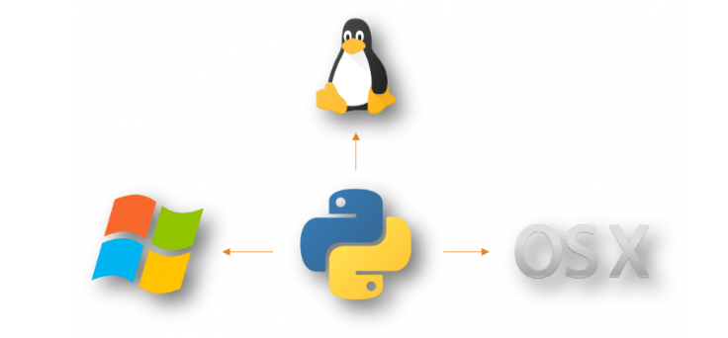
What is Python
Python is a free, open-source programming language. Therefore, all you have to do is install Python once, and you can start working with it.
Python is also a cross-platform compatible language. So, what does this mean? Well, you can install and run Python on several operating systems. Whether you have a Windows, Mac or Linux, you can rest assure that Python will work on all these operating systems.

Slide 3
It is also dynamically-typed because it carries out type-checking at runtime. It does so to make sure that the type of construct matches what we expect it to be.
The Python IDLE (Integrated Development Environment) executes instructions one line at a time.
Why is it called Python?
Guido van Rossum named it after the comedy group Monty Python.
The Python programming language was conceived in the late 1980s and was named after the BBC TV show Monty Python’s Flying Circus.
Guido van Rossum started implementing Python at CWI in the Netherlands in December of 1989. This was a successor to the ABC programming language which was capable of exception handling and interfacing with the Amoeba operating system.
On October 16 of 2000, Python 2.0 released and it had many major new features including cycle-detecting garbage collector for memory management and support for Unicode.
The next version of Python 3.0 released on December 3, 2008.

Slide 4
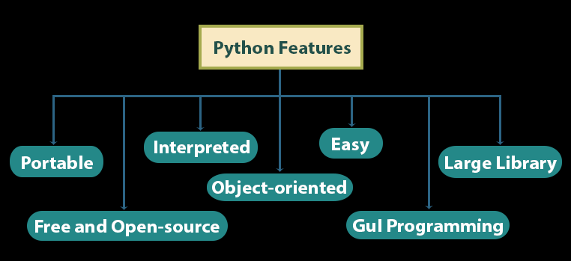
i. Easy
Python is very easy to learn and understand; any beginner can understand the basics of Python.
ii. Interpreted
It is interpreted(executed) line by line. This makes it easy to test and debug.

Slide 5
iii. Object-Oriented
The Python programming language supports classes and objects.
iv. Free and Open Source
The language and its source code are available to the public for free; there is no need to buy a costly license.
v. Portable
Since it is open-source, you can run Python on Windows, Mac, Linux or any other platform. Your programs will work without needing to the changed for every machine.
vi. GUI Programming
You can use it to develop a GUI (Graphical User Interface). One way to do this is through Tkinter.
vii. Large Library
Python provides you with a large standard library. You can use it to implement a variety of functions without needing to reinvent the wheel every time. Just pick the code you need and continue. This lets you focus on other important tasks.

Slide 6
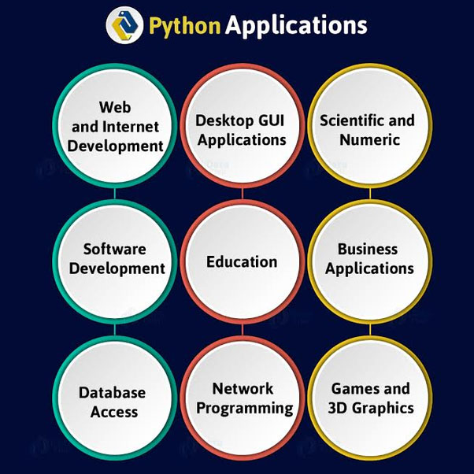

Slide 7
Python Applications
Build a website
Develop a game
Perform Computer Vision (Facilities like face-detection and color-detection)
Implement Machine Learning (Give a computer the ability to learn)
Enable Robotics
Perform Web Scraping (Harvest data from websites)
Perform Data Analysis
Automate a web browser
Perform Scripting
Perform Scientific Computing
Build Artificial Intelligence
Python isn’t limited to these applications. If you’ve ever used services from brands like YouTube, Dropbox, and Netflix, then you’ve been a consumer of Python.

Slide 8
Why learn Python ?
Easy to learn
Easy to write code
Big Community support
Used to make GUI applications
In demand
Learning python programming language is fun. If you compare Python with any other language, for example, Java or C++, then you will find that its syntax is a way lot easier. You also don’t have to worry about the missing semicolons (;) in the end!
Python is a Beginner's Language − Python is the first language of choice in many universities and even kids in school are learning to program with Python.
The Python language was designed to ease the programming with English like syntax.It is designed to be highly readable.
Python has the future in Big data, Artificial Intelligence, networking, etc.

Slide 9
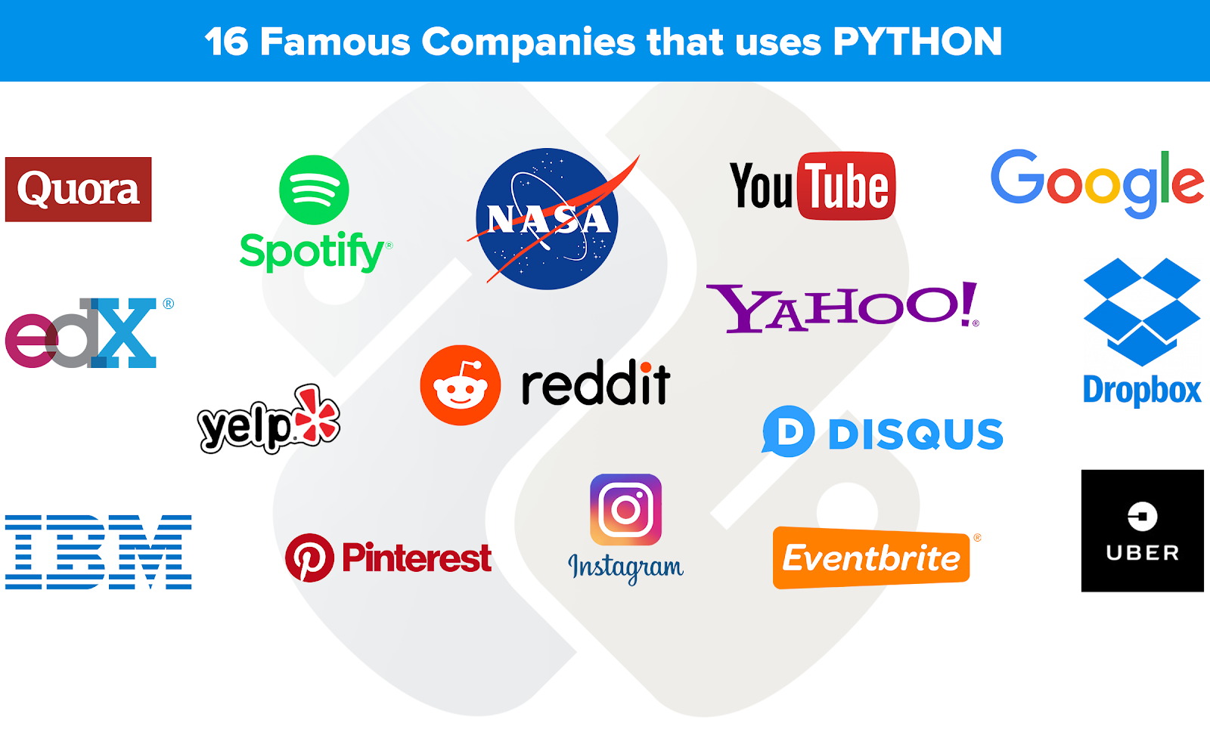

Slide 10
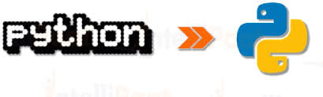
Versions Of Python
Python 3.8.3 – 13 May 2020.
Python 3.8.1 – 18 December 2019.
Python 3.8.0 – 14 October 2019.
Python 3.7.7 – 10 March 2020.
Python 3.7.6 – 18 December 2019.
Python 2.3 – 29 July 2003.
Python 2.2.1 – 10 April 2002.
Python 2.2p1 – 29 March 2002.
Python 2.0 – 16 October 2000.
Python 1.6 – 5 September 2000.
Python 1.5.2p2 – 22 March 2000.
Python 1.5.2p1 – 6 July 1999.
Python 1.4 – 25 October 1996.

Slide 11
